Slide 1
POH 114: SYSTEMS THINKING IN PANDEMIC PREPAREDNESS AND RESPONSE

Slide 2
Purpose
This topic seeks to facilitate learning of the inter-relationships among system elements, and the interactions of systems in complex, unpredictable environments to influence outcomes in pandemics and emergencies.

Slide 3
Objectives
This topic enables learning about:
Systems thinking, core concepts of its theories and characteristics, and their application in One Health interventions.
Systems thinking skills and tools in mapping One Health problems and create solutions to problems with practical strategies useful for field investigations.
One Health systems thinking skills to improve inter-professional, inter-discipline and cross-sectoral collaboration on key disease surveillance and outbreaks.
Systems thinking skills to improve multi-sectoral cooperation among national,​ regional and international government health officials along with multilateral health​ agencies in One Health interventions.​

Slide 4
Expected Learning Outcomes
At the end of this course the learner should be able to:
Define systems thinking, the core concepts of its theories and characteristics, and their application in One Health interventions.
Apply systems thinking tools for mapping One Health problems and create solutions to problems with practical strategies useful for field investigations.
Demonstrate One Health systems thinking to improve national, regional and international, inter-professional, inter-disciplinary and cross-sectoral collaboration on key disease surveillance and outbreaks

Slide 5
Competencies
Competency 1
Understand and describe the elements of complex problems and systems thinking
Competency 2
Create and use systems thinking maps to deepen understanding of OH problems
Competency 3
Develop solutions to OH wicked problems using systems thinking.

Slide 6
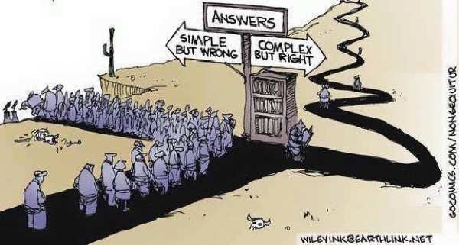
We need to face up to complexity in health systems
2

Slide 7
Systems Thinking for Health Systems
5
Foundations
APPLIED SYSTEMS
THINKING FOR HEALTH
SYSTEMS RESEARCH
A METHODOLOGICAL HANDBOOK
DON DE SAVIIGNY,, KARL BLANCHET
AND TAGHREED ADAM
2000
2007
2008
2012
2017
2009

Slide 8
Analytical Thinking
Understand what the various parts do
Take it apart
Assemble the understanding of the parts into an understanding of the whole

Slide 9
What is a System ?
System elements
System elements that work together or interact
System elements that work together to fulfill a purpose

Slide 10
Health Systems
WHO’s Original Health Systems Framework by 2008
7
How Health Systems work.
Inputs and Processes
Outputs
Outcomes
Impact
Improved:
survival
nutrition
equity
Governance
Financing
Human resources Medicines Information
Service delivery
Effective Coverage
Responsiveness
Reduced:
morbidity
impoverishment
But is this simple linear logic the way things really work?
Modified from: WHO Everybody’s business, 2008 & Health Metrics Network Framework

Slide 11
Systems Thinking
1. What is this a part of ?
2. What is the behavior of the whole ?
3. Disaggregate the understanding of the whole by identifying the role of the thing you are trying to explain
=
Why things work the way they do.

Slide 12
Systems Thinking
11
Systems thinking gives deeper insights into:
How a system works,
Why it has problems,
How it can be improved
Graphic adapted from Ahn A.C. et al. PLoS Med 3:956-960 (2006).

Slide 13
Systems Thinking
12
Systems thinking involves shifting attention…
from the | parts | to the | whole,
from | objects | to | relationships,
from | structures | to | processes,
from | hierarchies | to | networks,
from | rational | to | intuitive,
from | analysis | to | synthesis,
from | linear | to | non-linear thinking.
 |  |  | Adapted from Fritjof Capra

Slide 14
Some System Characteristics
Most Systems, including health systems, are:
Self-organizing Non-linear
Constantly changing History dependent
Tightly linked Counter-intuitive
Governed by feedback Resistant to change
Compiled and adapted from Sterman,2006 and Meadows et al, 1982 (32;42)

Slide 15
Connections and Consequences of Systems Thinking
The following are important to understand Systems thinking.
1. Understand the context of the system
2. Find connections between the parts, actors and processes of the system
3. Anticipate rather than react to the downstream consequences of changes in the system.

Slide 16
Skills in Systems Thinking
Traditional approach
Static thinking (Focusing on particular events)
Systems -as- effect thinking (Viewing behavior generated by a system as driven by external forces)
Tree by Tree Thinking (Believing that really knowing something means focusing on the details)
Factors thinking (Listing factors that influence or correlate with some result)
Straight-line thinking (Viewing causality as running in one direction ignoring the interdependence and interaction between and among the causes)
Modified from Richmond, 2000(28)
Systems thinking approach
Dynamic thinking (Framing a problem in terms of a pattern of behavior over time)
Systems -as-cause thinking (Placing responsibility for a behavior on internal actors who manage the policies and plumbing of the systems)
Forest thinking (Believing that to know something requires understanding the context of relationships
Operational thinking (Concentrating on causality and understanding how behavior is generated)
Loop thinking (Viewing causality as an on-going process, not a one-time event, with effect feeding back to influence the causes and the causes affecting each other).

Slide 17
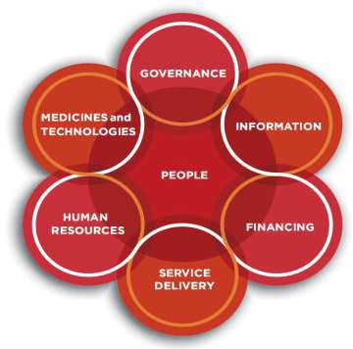
Tipping points
13
Small changes can produce big results !
but points of highest leverage are least obvious
There are no rules for finding tipping points, but there are ways of thinking that make it more likely.
Learning to look system-wide and see underlying processes, approaches and contexts rather than "events" is a starting point...

Slide 18
Tipping Points
14
Leverage points when intervening in a system
(in decreasing order of effectiveness)
The mind-set or paradigm out of which the system its goals, power structure, rules, culture arises.
Goals of the system
Distribution of power over the rules of the system
Rules of the system (incentives, constraints)
Information flows
Material flows
Driving positive feedback loops.
Regulating negative feedback loops
Constants, parameters, numbers, subsidies
Governance
We tend to work mainly at these levels
Modified from Donella Meadows

Slide 19
Systems Thinking in One Health
OH Challenge

Slide 20
Systems Thinking
Who has the disease
Who is impacted by the disease?
Who are the responders?
Who are other stakeholders?
OH Challenge
Who

Slide 21
Systems Thinking
OH Challenge
Who
Where
Who has the disease
Who is impacted by the disease?
Who are the responders?
Who are other stakeholders?
Where was the first case?
Where has it spread?

Slide 22
Systems Thinking
OH Challenge
Who
Where
When
Who has the disease
Who is impacted by the disease?
Who are the responders?
Who are other stakeholders?
When was the first case?
How quickly is it spreading?
Where was the first case?
Where has it spread?

Slide 23
Systems Thinking
Who has the disease
Who is impacted by the disease?
Who are the responders?
Who are other stakeholders?
OH Challenge
Who
Where
When
How
How is the disease transmitted?
How serious is it?
How can it be managed or controlled?
Where was the first case?
Where has it spread?
When was the first case?
How quickly is it spreading?

Slide 24
Systems Thinking
OH Challenge
Who
Where
When
How
What
Who has the disease
Who is impacted by the disease?
Who are the responders?
Who are other stakeholders?
What are the implications for human health?
Animal health?
Ecological health?
Where was the first case?
Where has it spread?
How is the disease transmitted?
How serious is it?
How can it be managed or controlled?
When was the first case?
How quickly is it spreading?

Slide 25
Systems Thinking
Who has the disease
Who is impacted by the disease?
Who are the responders?
Who are other stakeholders?
OH Challenge
Who
Where
When
How
What
Why
Why did the outbreak occur?
Where was the first case?
Where has it spread?
What are the implications for human health?
Animal health?
Ecological health?
When was the first case?
How quickly is it spreading?
How is the disease transmitted?
How serious is it?
How can it be managed or controlled?

Slide 26
Constructing System Maps
Introduction
Baseline maps (before interventions)
Map out interventions
Map after intervention (conclusion)

Slide 27
Format of a Systems Diagram
The following are the main steps in drawing system map:
1. Identify the main issue on which to draw a system of interest
2. Draw the main boundary around the system of interest, thereby specifying what falls within the system itself and what is in the environment
3. Identify each sub-system and draw a blob around it to establish its boundary.
4. Name the following;-
a) the system (title of the main system of interest)
b) components of subsystems
c) elements in the environment

Slide 28
Systems Thinking
What is a wicked Problem
Finding Solutions to One Health Wicked Problems through Systems Thinking
Notes:
Define wicked problems: Simply put, a complex problem for which there is no simple method of solution. Wicked problems tend to be a social or cultural problems that are difficult or impossible to solve for as many as four reasons: incomplete or contradictory knowledge, the number of people and opinions involved, the large economic burden, and the interconnected nature of these problems with other problems.Problems worth solving.

Slide 29
Wicked Problems.
There is no right way to approach a wicked problem
They are complex
They require multiple kinds of thinking.
They need multiple perspectives.
That is why One Health brings together a multi-disciplinary team to tackle some of the most complex health problems.

Slide 30
Systems Thinking Tools for Health Systems Research
24
Tools for describing and analysing situations
Causal Loop Diagrams
To visualize emergent behaviour and explore non-linear interrelationships
Systems Dynamics modeling
To explore consequences of non-linear relationships and modelling and testing solutions in whole systems
Social Network Analysis
To identify and map the stakeholders, the relations among stakeholders, and the structure of their network/systems
To plan, monitor and evaluate how complex interventions contribute to outcomes
Outcome Mapping
Process Mapping
To understand processes and how information flows in complex multi-stakeholder settings

Slide 31
Systems Thinking Tools for Health Systems Research
25
Tools for changing and managing situations
For understanding processes and how interventions might
Process mapping & modeling
integrate and work in the system
Boundary critique
For framing research methodological design in relation to the system boundaries
Approach for stakeholder and researcher participatory reflection on the problem
Soft systems methodologies
Complexity Analysis (Cynefin)
Sense making framework to distinguish simple, complicated, complex and chaotic situations and guide to managing risk
Human systems dynamics
A suite of tools for understanding self-organizing behaviour of actors in the system
Scenario technique
For simulating and reflecting on alternative solutions in strategic planning

Slide 32
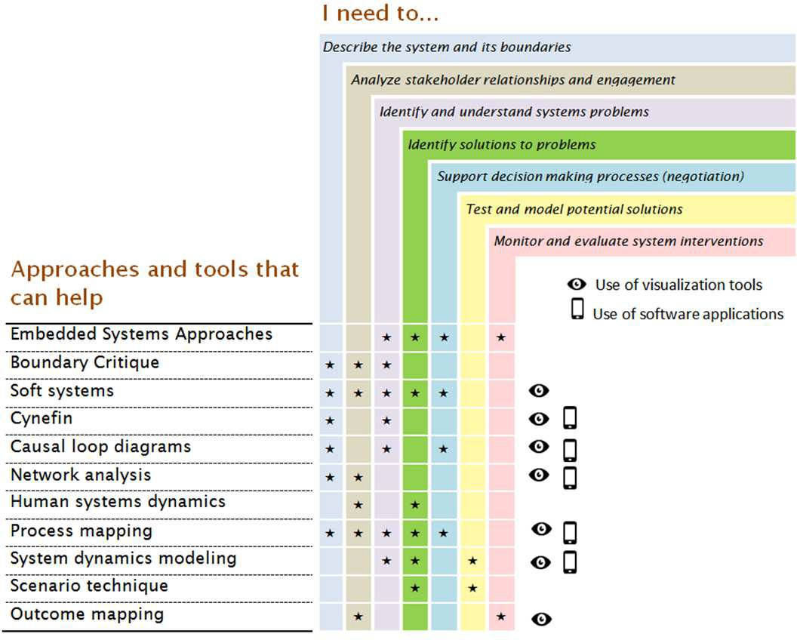
Application of Systems Thinking Tools and Approaches
2
For presentation in this symposium

Slide 33
References
Chepsaa https://www.hpsa-africa.org/
LSHTM https://www.lshtm.ac.uk/
Bradley DT, Mansouri MA, Kee F, Garcia LMT. A systems approach to preventing and responding to COVID-19. Clinical Medicine. 2020:100325. doi: 10.1016/j.eclinm.2020.100325 (https://www.ncbi.nlm.nih.gov/pmc/articles/PMC7118639/).
Brown G, Reeders D., Cogle A., Madden A., Kim J, O’Donnell D. A Systems thinking approach to understanding and demonstrating the role of Peer-Led programs and leadership in the response to HIV and Hepatitis C: Findings from the W3 Project. Front Public Health. 2018; 6:231. Doi: 10.3389/fpubh.2018.00231 (https://www.ncbi.nlm.nih.gov/pmc/articles/PMC6127267/pdf/fpubh-06-00231.pdf).
Chakraborty I, Maity P. COVID-19 outbreak: migration, effects on society, global environment and prevention. Sci Total Environ. 2020 Apr 22 ;728 :138882. doi: 10.1016/j.scitotenv.2020. (https://www.ncbi.nlm.nih.gov/pmc/articles/PMC7175860/pdf/main.pdf).National Incident Management System (NIMS). IS 800: http://www.training.fema.gov?EMIWeb/IS/is800.asp

Slide 34
Review of The Pandemic Preparedness with One Health approach (PPOH) short course is by the East African Community (EAC) Secretariat in cooperation with universities of the six EAC Partner States. It is facilitated by the German Government and implemented by the Deutsche Gesellschaft für Internationale Zusammenarbeit GIZ GmbH through the Global Programme Pandemic Prevention and Response, One Health (GP PPOH)

