Slide 1
POH 115: Antimicrobial Resistance and Pandemics

Slide 2
Purpose
This topic introduces learners to antimicrobials and factors influencing the emergence of antimicrobial resistance, and interactions that lead to the emergence of antimicrobial resistance from a One Health perspective.
Notes:
This can be read out, and presented as the elements that we use for a recapitulation session at the end of the day, or on the following day

Slide 3
Objectives
This topic seeks to enable learning about:
Common terminologies in AMR
Factors leading to the emergence, spread of antimicrobial resistance and its implications
One Health Approach in combating antimicrobial resistance
AMR prevention policies
Notes:
This can be read out, and presented as the elements that we use for a recapitulation session at the end of the day, or on the following day

Slide 4


Expected Learning Outcomes
By the end of this course, participants should be able to
1
3
  Promote the awareness of issues related to Antimicrobial Resistance
  Develop interventions that reduce Antimicrobial Resistance
2
4
  Advocate for Antimicrobial Resistance prevention policies
  Evaluate the principles of prevention, mitigation and response to Antimicrobial Resistance at various levels including community
Notes:
As an option for interactive approaches, the facilitator can ask the course participants to describe their expectations for the course

Slide 5
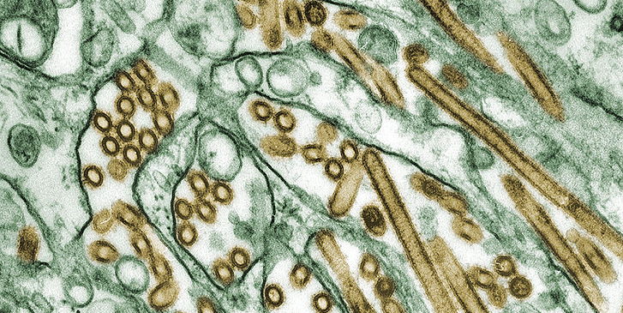
Antimicrobial Resistance (AMR): The Basics
Notes:
Here starts a new subtopic for this module

Slide 6
Interactions of Bacteria with Humans, Animals, Environment and Medicines
Humans
Animals
Environment
Notes:
Explain and discuss with participants, particularly using the experience of the participants
Use an example of an infectious agent, what is the relevance of the epidemiological triad for control of the infectious agent

Slide 7
What is AMR?
Antimicrobial resistance (AMR) occurs when bacteria, viruses, fungi and parasites no longer respond to medicines effectively. AMR makes infections harder to treat and increases the risk of disease spread, severe illness and death.
The emergence and spread of AMR have been accelerated by:
inappropriate use of antimicrobials in humans, animals and plants;
inadequate sanitation, hygiene, biosecurity, and infection prevention and control (IPC) measures in health care
settings, communities, farming and food production systems; and
a lack of equitable access to affordable and quality-assured antimicrobials, vaccines and diagnostics

Slide 8
Causes of AMR
Improper and non-prudent use of antimicrobial drugs in human and veterinary medicine and food production.
Limited awareness of the problem, lack of regulation for access to antibiotics, quality deficiencies due to counterfeit drugs and incorrect prescriptions or receipts are further challenges.
Lack of reliable diagnostic and monitoring systems for resistance.
Insufficient development of new antimicrobial substances for humans and animals.
The influence upon the environmental sector is also significant: for example, wastewater contaminated with antimicrobial substances, including from medical or agricultural facilities, can endanger the environment and the wider food chain.
The presence of resistant microorganisms and antimicrobial residues in production systems and food chains is also a potential route of exposure for the population.

Slide 9
Why AMR matters?
AMR has been described as a silent pandemic.
AMR will not only result in millions of excess deaths, greater suffering and increased health care costs, but also lead to the loss of animal lives, with severe effects on human livelihoods and food security.
The World Bank estimated that if AMR is not addressed, by 2050 the global economy may have lost nearly 4% of annual gross domestic product (GDP), with the losses being even greater in low- and middle-income countries (LMICs).
This situation could push up to 28 million people, most of them in developing countries, into poverty by 2050, mainly through the effects of AMR on economic productivity, livestock production and health care costs.

Slide 10
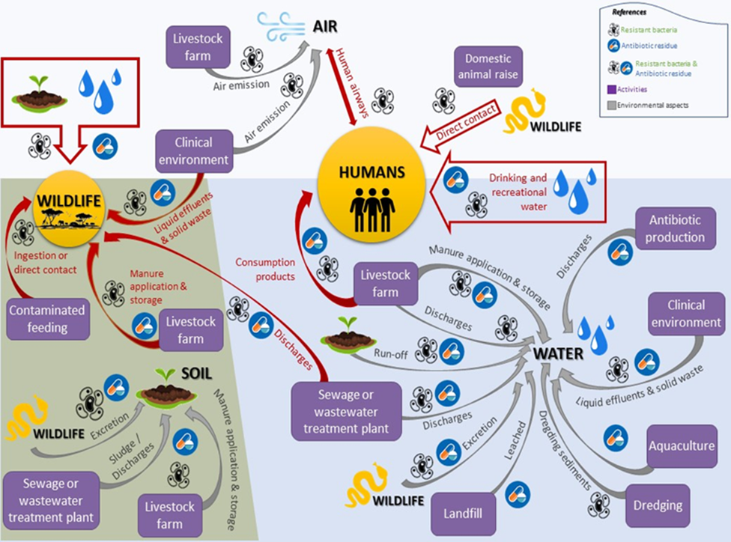
AMR is complex. This graphics underlines intersectoral dependencies with a focus on the environmental factors. Source: UNEP

Slide 11
Impacts of AMR
Globally, more than 4.9 million deaths were linked to AMR in 2019 - of which more than 1.2 million people died directly from infection with resistant bacteria.
AMR endangers the effectiveness of medical interventions, increases costs in the health system and poses a threat to global health and to global economic performance and development.
The world is heading towards a post-antibiotic era in which common infections could once again be lethal and routine medical procedures become high risk
AMR thus represents a complex problem that requires an approach with an interdisciplinary solution. To ensure that medicines continue to work in the future, a One Health approach is needed to systematically address the key challenges
The rise of antimicrobial resistance is hampering progress on many of the Sustainable Development Goals (SDGs), particularly in the areas of health and well-being, poverty reduction, food security, the environment, gender and sustainable economic growth.

Slide 12
AMR and Gender Imbalance
Women have biological (e.g., urinary tract infections, childbirth) and occupational (female dominated professions, such as in health care) factors, which overall increase the risk for infections and frequent use of antimicrobials
Successful AMR interventions need to consider traditional roles, e.g., that the administration of antimicrobial drugs to humans and animals is often coordinated and carried out by women, who usually fulfil the role of care givers.
Women may find themselves more affected by AMR than males

Slide 13
One Health (OH) approach in fighting AMR
AMR is known to have multiple drivers and needs to be tackled on many fronts. Hence, a One Health approach is essential to ensure that all sectors and stakeholders communicate and work together effectively.
One Health is a collaborative, multisectoral and transdisciplinary approach that recognizes the interconnections between people, animals, plants and their shared environment.

Slide 14
A One Health approach to AMR

Slide 15
Tackling AMR
Different fronts should be used; e.g.,
Education, training and awareness: To raise awareness and educate the population, professionals and policy makers on AMR
Surveillance: Improve detection and understanding of the AMR and antimicrobial use pattern
s and trends through surveillance
Infection prevention & control, good animal husbandry and biosecurity:
Rational use of antimicrobials
Sustainable Investment into AMR interventions and research into new antimicrobials and alternatives to antimicrobials

Slide 16
Education, Training and Awareness: Raise Awareness and Educate the Population, Professionals and Policy Makers on AMR
Improve awareness and understanding of AMR for the public, professionals and policy makers.
Strengthen the knowledge of human, animal and environment health professionals through improved curricula.
Educate farmers and animal keepers on AMR to support good antimicrobial use practices.
Strengthen the knowledge of school children on AMR at primary, secondary and tertiary level education.

Slide 17
Surveillance: Improve Detection and Understanding of the AMR and Antimicrobial Use Patterns and Trends Through Surveillance
Strengthen diagnostic laboratory capacity to improve healthcare professionals’ ability to make informed AMU decisions.
Integrate the surveillance for humans, animals and the environment into a ‘One Health’ integrated surveillance system.
Establish an AMU monitoring system for antimicrobials for human and animal use.
Analyze
and report surveillance data to support clinical and policy decision making in relevant sectors.
Strengthen capacities for generating and analyzing AMR/AMU data to inform policy development, better targeting of interventions and management decisions and to monitor progress
Surveillance of antimicrobial substances or resistant bacteria in water bodies and sanitation systems

Slide 18
Infection Prevention & Control, Good Animal Husbandry and Biosecurity:
Strengthen the existing biosecurity measures on hatcheries, farms, aquaculture establishments, slaughterhouses, and food processing establishments etc., for pathogen risk reduction
Improve movement controls of animals and animal products, and border control mechanisms to reduce trans-boundary animal disease occurrence transmission
Track and reduce the burden of Health-care Associated Infections (HAIs) through improving IPC practices in all health care facilities

Slide 19
Rational Use of Antimicrobials
Improving access to quality assured antimicrobials to animal keepers by increasing access points for the sale and provision of antimicrobials.
Strengthening control of antimicrobials and their use in animal health by farmers and para veterinarians without limiting access.
Implementing sustainable supervision, audit and feedback mechanisms in health facilities by having functional medicines therapeutic committees in health institutions to ensure appropriate antimicrobial use by prescribers.
Ensuring that Standard Treatment Guidelines (STG’s) and the Essential Medicines List (EML) reflect the current resistance patterns and pathogens in humans and animals.
Ensuring adequate supplies of quality assured essential antimicrobials at various levels of human and animal health delivery systems.
Controlling public access to prescription only antimicrobials at the point of the pharmacy and veterinary medicine general dealers (VMGDs).
Strengthening regulations to ensure appropriate use of antimicrobials in animals.
Promoting stewardship and pharmacovigilance in the use of antimicrobials

Slide 20
Investment, Research & Development
Sustainable Investment into AMR interventions and research into new antimicrobials and alternatives to antimicrobials
Ensure sustainable investment in countering AMR
Develop innovative modern diagnostics, vaccine and alternative therapy to AMR.

Slide 21
Key Pillars of the Strategy to Ensure the Sustainability of the AMR Prevention Program
Surveillance of AMR and antimicrobial use (AMU) patterns in animals, humans and crops.
Prevention, which will reduce the need for antimicrobials through effective IPC, farm biosecurity and good farm practices, WASH and immunization
Rational antimicrobial use, which seeks to improve controlled access to antimicrobials and to optimize responsible use in animals and humans
Investment in research and development which seeks innovative ideas of alternatives to antimicrobials or quicker diagnostic techniques.

Slide 22
GHSA
The Global Health Security Agenda came about as an international collaborative effort, working multilaterally among governments and across sectors, seeking to implement the IHR and develop the capacities to prevent, detect, and respond to public health emergencies of international concern.
GHSA is an effort between nations, international organizations, and civil society to accelerate progress toward a world safe and secure from infectious disease threats whether naturally occurring, deliberate, or accidental, and to promote global health security as a national and international priority.
Agencies involved are the World Health Organization (WHO), the Food and Agriculture Organization (FAO), and the World Organization for Animal Health (OIE)

Slide 23
GHSA continued…
The GHSA is an effort by nations, international organizations, and civil society to accelerate progress toward a world safe and secure from infectious disease threats; to
Promote global health security as an international priority
Establish capacity to prevent, detect and rapidly respond to biological threats, whether naturally occurring, intentional, or accidental.
The GHSA will spur progress toward full implementation of WHO IHR 2005, OIE Performance of Veterinary Services (PVS) pathway, and other relevant global health security frameworks.

Slide 24
Why Global Health Security
New diseases are occurring and spreading, drug resistance is rising
More laboratories are working with dangerous bacteria and viruses.
Global travel and trade increase these risks

Slide 25
GHSA Packages
The GHSA provides concrete action plans for
Prevention of avoidable epidemics,
Early detection of threats, and
Rapid and effective response against infectious disease outbreaks
The Action Packages are designed to accelerate progress toward these goals by facilitating regional and global collaboration toward specific GHSA objectives and targets

Slide 26
Action Packages
These are designed to outline measurable steps required to prevent outbreaks, detect threats in real time, and rapidly respond to infectious disease threats that may occur naturally, as a result of laboratory accidents, or as an act of bioterrorism. The packages are;
Reporting
National Laboratory System
Workforce Development
Respond:
Emergency Operations Centers
Multi-sectoral Rapid Response
Medical Countermeasures and Personnel Deployment
Prevent:
Antimicrobial Resistance
Zoonotic Disease
Biosafety and Biosecurity
Immunization
Detect:
Real-Time Surveillance

Slide 27
Biosecurity
Is a process to reduce or eliminate the ability of a biological agent to adversely affect human, animal, or plant health, as well as the economy or the environment
It is the management of biological and environmental risks, whether the risks come from the agents themselves, infectious species or biological weapons
It is also the protection of agents or facilities against the theft or diversion of high consequence microbial agents, which could be used by someone who maliciously intends to conduct bio-terrorism or pursue biological weapons proliferation

Slide 28
Biosafety
Biosafety is the process used to prevent people and the environment from being exposed to hazardous biological agents
It is about safety handling infections agents through the application of infections agents through the application of proper techniques, equipment's, and personal behavior
The simple phrase used to distinguish biosafety from biosecurity is: Biosafety is about protecting people from bad bugs; biosecurity is about protecting bugs from bad people

Slide 29
Biosafety Levels for Infectious Agents
BSL | Agent | Equipment and facilities for appropriate barriers
1 | Do not usually lead to disease in healthy adults e.g. non pathogenic E. coli | PPE
2 | Cause disease but not through inhalation | As in 1 but add autoclave
3 | Cause serious potential lethal disease through inhalation | As in 2 plus physical separation
4 | Are dangerous/exotoxic frequently fatal No vaccines or treatments High risk of aerosol transmission | As in 3 plus All primary barriers, full body, air supplied positive pressure, isolation, dedicated supply and exhaust and vacuum and decontamination

Slide 30
Biorisk
It generally refers to the risk associated with biological materials and/or infectious agents. The term has been used frequently for various purposes since the early 1990s
The term is used by regulators, laboratory personnel and industry alike and is used by WHO
Is a name given to the chance that any type of adverse event leading to potential harm will occur

Slide 31
Biorisk Management
Refers to development of strategies (biosafety, biosecurity techniques) to minimize occurrences
Biorisk management is an ongoing process in which: specific laboratory biorisk control measures are regularly monitored, and when warranted the control measures are corrected to ensure they are working as expected

Slide 32
References
Centers for Disease Control and Prevention (CDC). Global Health Security Agenda [Internet]. Atlanta (GA): CDC; 2014 www.cdc.gov/globalhealth/security
Global Health Security Agenda http://www.globalhealth.gov/global-health-topics/global-health-security/ghsagenda.html
Department of Health and Human Services o CDC – Global Health Security www.cdc.gov/globalhealth/security/
Field Epidemiology Training Programs www.cdc.gov/globalhealth/fetp
Notes:
The summary of this important topic should hinge on terms and concepts, justification of One Health, sectors involved, drivers

Slide 33


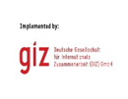
Review of The Pandemic Preparedness with One Health approach (PPOH) short course is by the East African Community (EAC) Secretariat in cooperation with universities of the six EAC Partner States. It is facilitated by the German Government and implemented by the Deutsche Gesellschaft für Internationale Zusammenarbeit GIZ GmbH through the Global Programme Pandemic Prevention and Response, One Health (GP PPOH)

