Slide 1
POH 119 : INFECTION PREVENTION AND CONTROL IN PANDEMICS

Slide 2
Purpose
This topic introduces learners to essential skills and practice of infection prevention towards controlling infectious diseases.

Slide 3
Objectives
This topic enables learning about:
Key terms and principles of infection prevention and control
Types of personal protective equipment
The practice of donning and doffing
The importance of IPC in controlling infections

Slide 4
Expected Learning Outcomes
By the end of this topic learners should be able to:
Describe key terms and principles of infection prevention and control
Explain types of personal protective equipment
Demonstrate donning and doffing
Discuss the importance of IPC in controlling infections

Slide 5
Discussion around Covid-19 And IPC
Ensuring triage, early recognition, and source control (isolating patients with suspected 2019-nCoV
Application of Standard Precautions for all patients
Implementation of empiric additional precautions (droplet and contact and whenever applicable airborne precautions) for suspected cases. Consider Airborne precautions for aerosol-generating procedures
Administrative controls
Environmental and engineering controls

Slide 6
Goals of Infection Prevention and Control
Protect yourself
Protect your community
Protect your patients

Slide 7
Ensuring Triage, Early Recognition and Source Control
Encourage HCWs to have a high level of clinical suspicion, and use updated case definitions
Establish a well-equipped triage station at the entrance of health facilities
Reinforce adherence to standard precautions especially respiratory hygiene and hand hygiene
Ensure that patients with symptoms of suspected 2019-nCoV or other respiratory infection (e.g., fever, cough) are not allowed to wait among other patients seeking care. Provide a face mask to symptomatic patients

Slide 8
Applying Standard Precautions for All Patients
Hand hygiene
Respiratory hygiene
Appropriate personal protective equipment (PPE) according to risk assessment
Injection safety practices/Sharps safety
Safe waste management
Proper linens, environmental cleaning and sterilization of patient-care equipment.

Slide 9
Implementing Empiric Additional Precautions
Patients should be placed in adequately ventilated single rooms.
When single rooms are not available, patients suspected of being infected with 2019-nCoV should be grouped together (Cohorting)
All patients’ beds should be placed at least 1 m apart regardless of whether they are suspected to have 2019-nCoV infection or not

Slide 10
Additional Contact and Droplet Precautions
Use designated equipment for patients under investigation/Confirmed patients
If transport is required, use predetermined transport routes to minimize exposure for staff, other patients and visitors, and have the patient using a medical mask;
Routinely clean and disinfect surfaces which the patient is in contact
Maintain a record of all persons entering the patient’s room, including all staff and visitors.

Slide 11
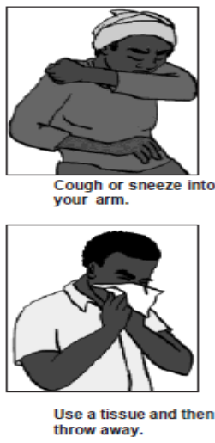
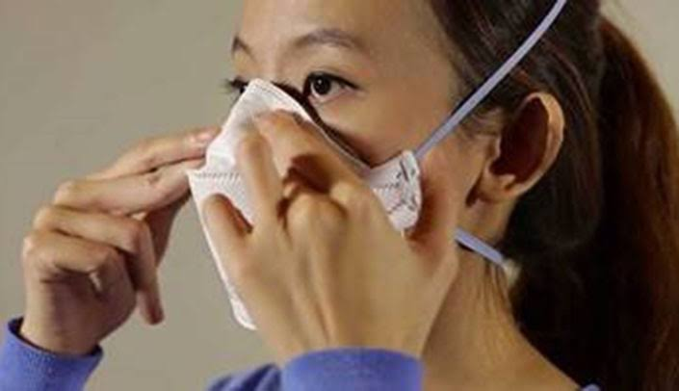
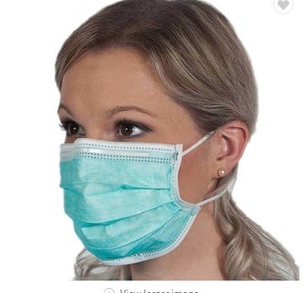
Respiratory or Cough Etiquette
Cover mouth and nose when coughing and sneezing
Maintain social distance (1.5metres) from others
Cover mouth and nose with tissue and dispose of the used tissues in the nearest waste bin
Health workers must put on fit tested N95 masks before entering the patient area or patient care
Use of a face mask for suspected cases, especially in public.

Slide 12
Isolation
Room doors should be kept closed except when entering or leaving the room, and entry and exit should be minimized. Patient movement out of the room should be minimized as well
Once a proper isolation room, the patient’s facemask may be removed.
Outside the isolation room, patients should wear a facemask to contain secretions and droplets
Personnel entering the room should use PPE, including respiratory protection, as described below.
In addition, the room should undergo appropriate cleaning and surface disinfection before it is returned to routine use.

Slide 13
Implementing Administrative Controls
Administrative controls and policies for the prevention and control of transmission of infections within the healthcare setting include
Establishing sustainable IPC infrastructures and activities;
Educating patients’ caregivers;
Developing policies on the early recognition of acute respiratory infection potentially caused by 2019-nCoV;
Ensuring access to prompt laboratory testing for identification of the etiologic agent;
Preventing overcrowding, especially in the emergency department;
Providing dedicated waiting areas for symptomatic patients;
Appropriately isolating hospitalized patients;
Ensuring adequate supplies of PPE;
Ensure the adherence of IPC policies and procedures for all facets of health care.

Slide 14
Administrative Measures Related to Healthcare Workers
Provision of adequate training for HCWs
Ensuring an adequate patient-to-staff ratio
Establishing a surveillance process for acute respiratory infections potentially caused by 2019-nCoV among HCWs
Monitoring HCW compliance with standard precautions and providing mechanisms for improvement as needed.

Slide 15
Using Environmental and Engineering Controls
Spatial separation of at least 1 meter should be maintained between all patients.
Ensure that cleaning and disinfection procedures are followed consistently and correctly.
Cleaning environmental surfaces with water and detergent and applying commonly used hospital disinfectants (such as sodium hypochlorite) is an effective and sufficient procedure.
Manage laundry, food service utensils and medical waste in accordance with safe routine procedures.

Slide 16
Recommendation for Outpatient Care
Triage and early recognition
Emphasis on hand hygiene, respiratory hygiene and facemasks to be used by patients with respiratory symptoms
Prioritization of care of symptomatic patients
When symptomatic patients are required to wait, ensure they have a separate waiting area have a facemask
Educate patients and families about the early recognition of symptoms, basic precautions to be used and which health care facility they should refer to.

Slide 17
Hand Hygiene
Hand hygiene is the most important measure to prevent infection
Perform hand hygiene after contact with respiratory secretions.

Slide 18
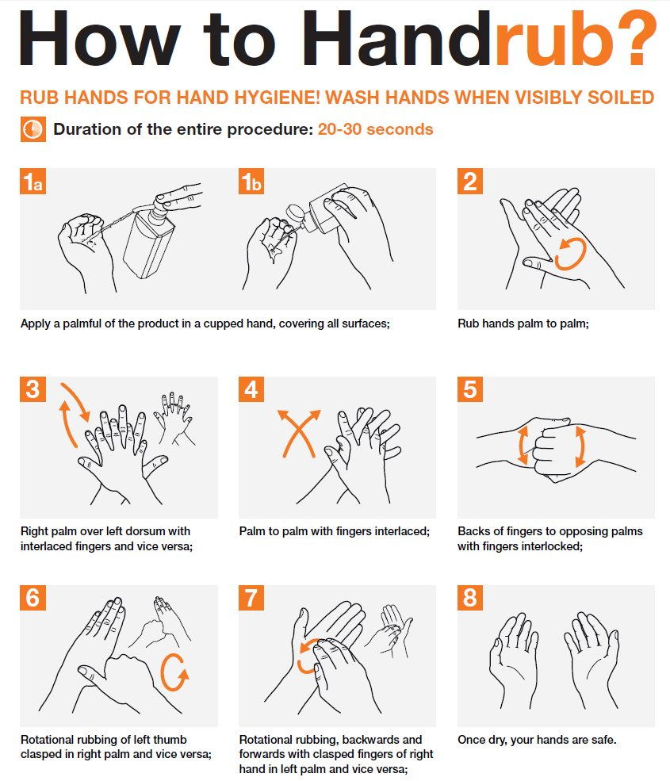

Slide 19
Personal Protective Equipment (PPE)
PPE recommendation for the general public:
For asymptomatic individuals, no PPE use is recommended. However proper hand hygiene practices and respiratory etiquette should suffice
For Health workers Supporting Triage or high risk gatherings
-In addition to standard precautions, rapidly identify people with respiratory symptoms and put a face mask on them.
-Screening teams should use fitted N95 respirators
-Symptomatic staff are advised to stay home and inform relevant authorities
For Health workers caring for confirmed cases
-In addition to standard precautions, health workers to use facial protection (Goggles), fitted respirators, gowns, gloves, and observe the 5 moments of hand hygiene

Slide 20
Rational use of PPEs
Summarizes WHO’s recommendations for the rational use of personal protective equipment (PPE) in healthcare and community settings, as well as during the handling of cargo.
PPEs includes
- Gloves, Medical masks, Goggles or a Face Shield, and Gowns, as well as for specific procedures, Respirators (i.e., N95 orFFP2 standard or equivalent) and aprons.
This presentation is intended for those who are involved in distributing and managing PPE, as well as public health authorities and individuals in healthcare and community settings.
It aims to provide information about when PPE use is most appropriate.

Slide 21
Examples of PPE for Use in Health Care Settings During COVID-19
Face Mask
N95 Mask Face shield
Goggle
Nose + mouth
Gown
Nose + mouth
Apron
Eyes + nose + mouth
Eyes
Gloves
Head cover
Head + hair
Body
Hands
Body

Slide 22
Strategies to Optimize the Availability of PPE

Slide 23
Setting | Target personnel or patients | Activity | Type of PPE or procedure
Healthcare Facilities Inpatient Facilities Patient Room | Healthcare workers | Providing direct care to COVID-19 patients. | Medical mask; Gowns, Gloves, Eye Protection (Goggles or Face shield) Gown
 |  | Aerosol-generating procedures performed on COVID-19 patients. | Respirator N95 or FFP2 standard or equivalent,Gown,Gloves, Eye protection, Apron
 | Cleaners | Entering the room of COVID-19 patients. | Medical Mask, Glove, Heavy duty gloves, Eye protection (if at risk of splashes from organic materials/chemicals) Boots or closed shoes
 | Visitors | Entering the room of a COVID-19 patient | Medical mask Gown Gloves

Slide 24
Setting | Target personnel or patients | Activity | Type of PPE or Procedure
Other areas of patient transit (e.g., wards, corridors). | All staff, including healthcare workers. | Any activity that does not involve contact with COVID-19 patients. | No PPE required
Triage | Healthcare workers | Preliminary screening Not involving direct contact | Maintain spatial distance of at least 1 m. No PPE required
 | Patients with Respiratory symptoms. | Any | Maintain spatial distance of at least 1 m. Provide medical mask
 | Patients without respiratory symptoms. | Any | No PPE required
Laboratory | Lab technician | Manipulation of respiratory samples. | Medical mask, Gown, Gloves, Eye protection (If at risk of chemical splash)
Administrative areas | All staff, including healthcare workers. | Administrative tasks that do not involve contact with COVID-19 patients | No PPE required

Slide 25
Consultation room | Healthcare workers | Physical examination of patient with respiratory symptoms. | Medical mask, Gown, Gloves and Eye protection.
 | Healthcare workers | Physical examination of patients without respiratory symptoms. | PPE according to standard precautions and risk assessment.
 | Patients with respiratory symptoms. | Any | Provide medical mask
 | Patients without respiratory symptoms. | Any | No PPE required
 | Cleaners | After and between consultations with patients with respiratory symptoms. | Medical Mask, Glove, Heavy duty gloves, Eye protection (if at risk of splashes from organic materials/chemicals) Boots or closed shoes
Waiting room | Patients with respiratory symptoms. | Any | Provide medical mask. Immediately move patient to an isolation room or separate away from others. If this is possible, ensure spatial distance of at least 1m from other patients. No PPE required.
 | Patients without respiratory symptoms. | Any | No PPE required

Slide 26
 |  | Activity | Type of PPE or procedure.
Community
Home | Patients with respiratory symptoms. | Any | Maintain spatial distance of at least 1 m. Provide medical mask
 | Caregiver | Entering the patient’s room, but not providing direct care or assistance. | Medical mask
 | Caregiver | Providing direct care or when handling stool, urine or waste from COVID-19 patient being cared for at home. | Gloves, Medical Masks, Apron
 | Healthcare Workers | Providing direct care or assistance to a COVID-19 patient at home | Medical mask, Gown, Gloves, Eye protection
Public areas (e.g., schools, shopping malls, Train stations). | Individuals without respiratory symptoms | Any | No PPE required

Slide 27
Setting | Category of person | Activity | Type of PPE
Ambulance or transfer vehicle | Healthcare workers | Transporting suspected COVID-19 patients to the referral healthcare facility. | Medical mask Gowns, Gloves, Eye protection
 | Driver | Involved only in driving the patient with suspected COVID-19 and the driver’s compartment is separated from the COVID-19 patient. | Maintain spatial distance of at least 1 m. No PPE required.
 |  | Assisting with loading or unloading patient with suspected with suspected COVID-19 disease. | Medical mask, Gown, Gloves, Eye protection
 |  | No direct contact with patient with suspected COVID-19 but no separation between driver’s and patient’s compartment | Medical mask
 | Patient with Suspected COVID | Transport to the referral healthcare facility. | Medical mask if tolerated
 | Cleaners | Cleaning after and between transport of patients with suspected COVID-19 disease to the referral healthcare facility. | Medical mask, Gown, Heavy duty gloves, Eye protection (if risk of splash from Organic material or chemicals). Boots or closed work shoes

Slide 28
Donning and Doffing of PPE
OVERVIEW
Comprehensive steps for donning and doffing of PPE are illustrated in the link below
https://www.who.int/publications/i/item/WHO-HIS-SDS-2015.1

Slide 29
Airborne Precautions
(in the context of COVID-19)
Airborne precautions are recommended ONLY for aerosol generating procedures such as:
bronchoscopy,
tracheal intubation,
pressure on the chest during cardiopulmonary resuscitation may induce production of aerosol.
The following is required:
Single room with adequate ventilation:
natural ventilation with air flow of at least 160 L/s per patient or
in negative pressure rooms with at least 12 air changes per hour and controlled direction of air flow when using mechanical ventilation
PPE: contact + droplet
Substitute medical mask for high-efficiency masks in room (N-95, or FFP2 or equivalent masks)

Slide 30
N95 Mask Fitting –
Do a seal check before you enter the room!

Slide 32
Minimize Direct Unprotected Exposure to Blood and Body Fluids
SCENARIO | HAND HYGIENE | GLOVES | GOWN | MEDICAL MASK | EYE- WEAR
Always before and after patient contact, and after contaminated environment | x
If direct contact with blood and body fluids, secretions, excretions, mucous membranes, non-intact skin | x | x
If there is risk of splashes onto the health care worker’s body | x | x | x
If there is a risk of splashes onto the body and face | x | x | x | x | x
If exposed to all risks above PLUS risk of droplet inhalation either from the patient coughing or from a procedure generating aerosol | x | x | x | x | x

Slide 33
Summary of Recommendations
General Public | Screening and High risk Gatherings | Patient care setting
Observe proper hand hygiene using ABHR or soap and water Keep a 2m distance from patients with respiratory symptoms Try as much as possible to avoid hand contact with facial mucosa Proper respiratory manners No PPE required | Put face masks on a patients with respiratory symptoms Observe standard precautions Stay home when you are sick | Use of PPE including Disposable Gowns, goggles, respirators, gloves and hand hygiene Dedicate equipment for use on PUIs for nCov19 Monitor and manage all exposed and symptomatic HCWs

Slide 34
Reference Materials
Minimum requirements for infection prevention and control. Geneva: World Health Organization; 2019. License: CC BY-NC-SA 3.0 IGO.
Guidelines on core components of infection prevention and control programmes at the national and acute health Care facility level. Geneva: World Health Organization; 2016. Licence: CC BY-NC-SA 3.0 IGO.
Mugerwa et al (2013). High Prevalence of tuberculosis infection among medical students in Makerere University, Kampala [online]. Available: http://www.ncbi.nlm.nih.gov/pmc/articles/PMC3642000.
The Health Care Infection Society (2013). Prevalence of hospital-associated infections can be decreased effectively in developing countries [online]. Available: http://www.ncbi.nlm.nih.gov/pubmed/23643293.
WHO (2014) Bulletin; Health care-associated infection in Africa [online]. Available: http://www.who.int/patientsafety/news/cleancare_articles/en. Accessed 8th May 2014

Slide 35
Review of The Pandemic Preparedness with One Health approach (PPOH) short course is by the East African Community (EAC) Secretariat in cooperation with universities of the six EAC Partner States. It is facilitated by the German Government and implemented by the Deutsche Gesellschaft für Internationale Zusammenarbeit GIZ GmbH through the Global Programme Pandemic Prevention and Response, One Health (GP PPOH)

