Slide 1

Global Programme Pandemic Prevention & Response, One Health.
Nutrition , food safety and food security in Pandemics
Code:
Notes:
The facilitator should introduce him/herself briefly, including the capacity for Pandemics and One Health

Slide 2
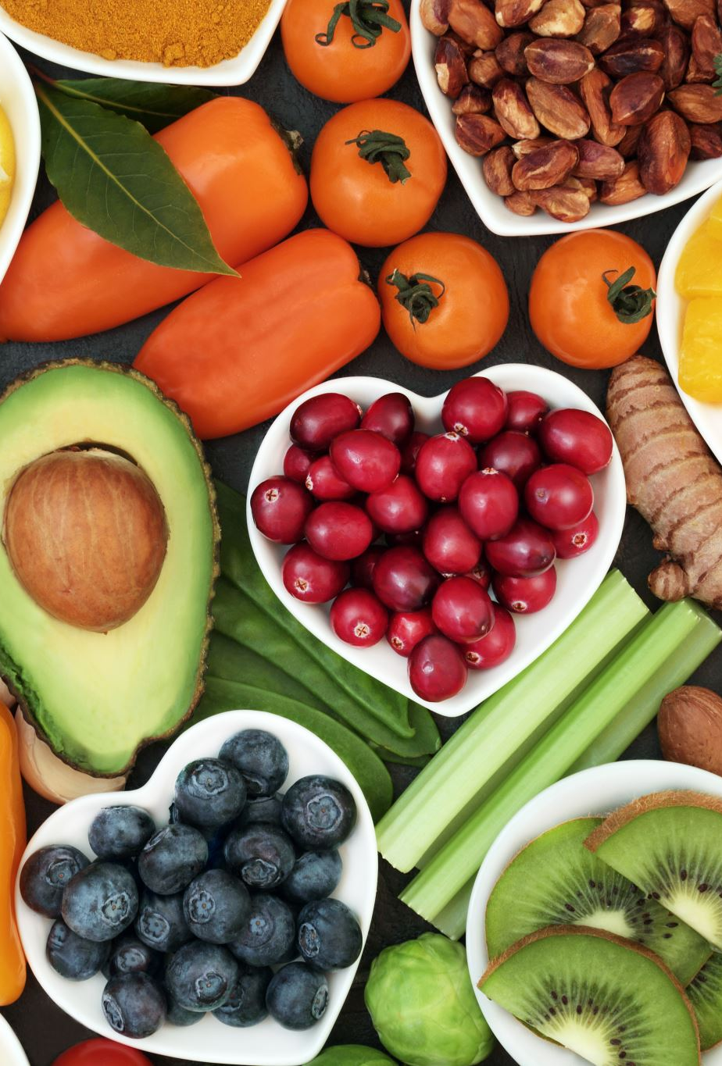
Purpose
  To enable learners, understand the importance and approaches for providing assurance that food safety and nutrition for prevention and management of pandemics
Notes:
This can be read out, and presented as the elements that we use for a recapitulation session at the end of the day, or on the following day

Slide 3
Learning objectives
This topic enables learners about:
Terms used in food safety, security and nutrition in pandemics
Food security and nutrition challenges emerging during pandemics ( food type, food adulteration , contaminant and food hazards
Food safety and quality assurance approaches and programs for preventions and management of food borne pandemics
Appropriate nutritional needs and interventions for vulnerable population during pandemics
Notes:
This can be read out, and presented as the elements that we use for a recapitulation session at the end of the day, or on the following day

Slide 4
Expected learning outcomes
At the end of this module learners should be able to:
Define terms used in food safety, security and nutrition in pandemics
Identify food security and nutrition challenges emerging during pandemics ( food type, food adulteration as well as contaminant and food hazards)
Identify food safety and quality assurance approaches and programs for preventions and management of food borne pandemics
Determine appropriate nutritional needs and interventions for vulnerable population during pandemics

Slide 5
Definition of terms
FOOD
Solid/liquid that contains essential nutrients
Produce energy and maintain life when ingested and assimilated
Nutrition
Study of foods and how our bodies use them
Concerned with how food is produced, processed, handled, sold, prepared, shared and eaten
In the body: how food is digested, absorbed and assimilated
Macronutrients (required in relatively large amounts)
  Energy-giving foods (carbohydrates and fats) and body-building foods (proteins)
Micronutrients ( need in relatively small amount)
Protective food ( vitamins and minerals)

Slide 6
Malnutrition
A condition that results from taking an unbalanced diet in which certain nutrients are lacking (too high or less intake)
Nutritional Status assessment
It is the analysis of anthropometric, biochemical , clinical and dietary data.
Determine whether a person or groups of people are well nourished or malnourished (over or under-nourished).

Slide 7
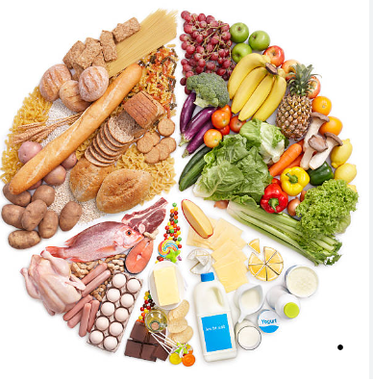
Illustration of various food goups
PROTEINS (Most complex of the macronutrients)
Composed of carbon, hydrogen, oxygen, nitrogen and sulphur.
Constituents of muscle, bone, nails, hair.
Building blocks are amino acids
2 types of amino acids
Essential a.as (9) must be provided by food because our bodies cannot make them from other substances in quantities sufficient for our requirements. Examples: histidine, lysine, tryptophan, methionine, etc

Slide 8
Non-essential a.as(11) can be produced by the body from other amino acids. E.g alanine, glutamine, glycine, cysteine, etc
Examples
Animal based : meat, fish, eggs, milk, etc.
Plant based : Soy , beans or lentils
Functions of proteins in the body
Tissue building and repair
Body fluids
enzymes
Immunity (antibodies)
Energy source (1g=4kcal)

Slide 9
Carbohydrates
Organic molecules made up of carbon, hydrogen and oxygen.
Building blocks are small units called simple sugars/ saccharides.
Monosaccharides, disaccharides and polysaccharides, depending on the number of unit sugars.
Functions of carbohydrates in the body
Main source of energy (1g=4kcal)
Increase bulk of food (complex CHOs=satiety, weight loss?)
prevent constipation (fiber)
Soak up harmful substances in the guts (passed out in faeces), etc

Slide 10
Fats/oils
Fats: hard at room temperature, e.g butter, margarine, ghee, lard
Oils: liquid at room temp, e.g., cooking oils
Composed of Carbon, hydrogen , oxygen and sometimes, phosphorus.
Building blocks are: 3 fatty acids and glycerol
Fatty acids also divided:
Essential fatty acids: linolenic acid , linoleic acid, and oleic acid
Non-essential fatty acids: arachidonic acid, palmitic acid, stearic acid, lauric acid, etc
Functions of fats/oils in the body
Concentrated source of energy (1g=9kcal)
Important energy store in the body and component of body cells
Absorption of some vitamins, eg vit A, D, E, K

Slide 11
Vitamins
Chemical compounds required in very small amounts
Important for maintenance of normal health and performance of the body.
Classified into 2:
  Fat-soluble vitamins; soluble in lipids but insoluble in water, can be stored in the body. E.g A,D,E,K
  Water-soluble vitamins; soluble in water (what is the consequence?), not stored in the body hence need to be consumed on a daily basis. E.g vit C and B- vitamins

Slide 12
  Functions of vitamins
Prevent infections e.g vit A
Help in release of energy from foods (B-vitamins)
Eye and skin health, vits A,D
Formation of red-blood cells (prevention of anaemia)
Help in absorption of iron from food (vit C)
Help to destroy free radicals in the body/antioxidants(prevention of cancer?)
Sources of vits incl: vegetables, fresh and dried fruit, milk, whole grains etc

Slide 13
Minerals and Fiber
Minerals
Needed in small amounts to facilitate chemical processes in the body
Food content of minerals is affected by the environment in which the source crop or animal grows, i.e soil and feed
Examples: iron, iodine, zinc, selenium, sodium, potassium, etc
Sources: liver, green leafy vegetables, pumpkin seeds, milk, etc
Fiber
• Fiber adds bulk to food and is important in the functioning of the digestive
Fiber is a type of complex carbohydrate that is found in plants.
A high-fiber diet: prevent heart disease, reduce the risk of colon cancer and prevent constipation

Slide 14
Water
Made up of hydrogen and oxygen
Did you know it is not nutrient but very essential for life……………………..
The total amount of water in the body of an average adult is 37 litres.
Human brains are 75% water.
Human bones are 25% water.
Human blood is 83% water.
Various functions:
  Regulation of body temperature
  Carries nutrients throughout the body and aids digestion
  Component of important body fluids , eliminates wastes and toxins from the body
  Moistens tissues/organs in the body

Slide 15
Nutritional needs for differents groups in emergency situation
Hunger and malnutrition are common among refugees and displaced populations
Most affected are infants, children, adolescents, pregnant and lactating mothers, immunosuppressed and older people
Besides wasting, deficiencies of iodine, vitamin A and iron are common in emergency situation.
In addition, scurvy, pellagra and beriberi frequently occur in populations entirely dependent on food aid.
The levels of risk of malnutrition in emergencies depends on factors such as the degree of civil security, food availability and accessibility, access to health services, and adequacy of assistance delivery.
Discuss more about their nutrition need for different stage of life!!!

Slide 16
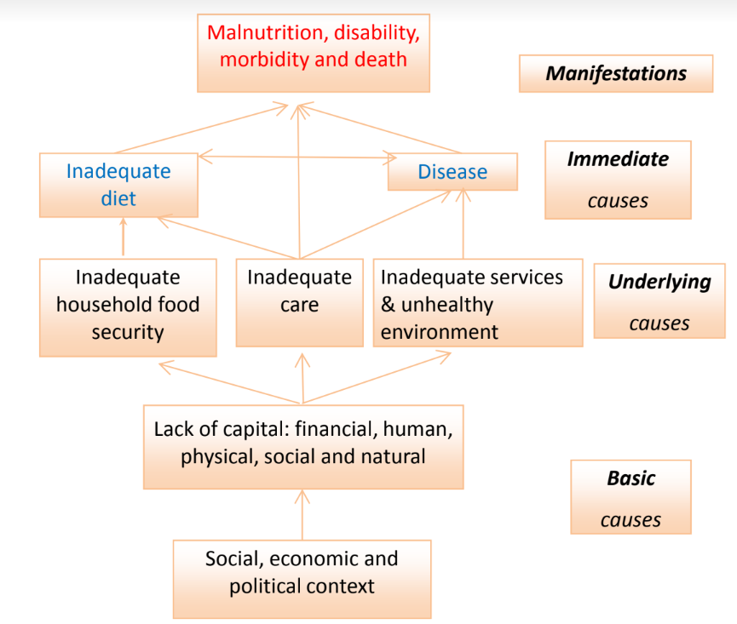
Conceptual Framework of the Causes of Malnutrition (UNICEF 1990)
.

Slide 17
Interventions to prevent and control nutritional disorders
Micronutrient malnutrition
caused an inadequate intake of one or more vitamins or minerals
leads to impaired immunity as well as direct morbidity and mortality.
Infectious diseases can worsen the problem of an inadequate diet (vicious cycle).
Micronutrient deficiencies rank among the top twenty risk factors for morbidity.
Amelioration of these deficiencies is among the most cost effective of public health interventions in improving overall health and outcomes of common infectious diseases and the quality of life
The following are some of the approaches for preventing malnutrition
Require a combination of approaches for effective strategy ( no single approach works)

Slide 18
1) Inclusion of nutrient rich foods in the diet
In emergency situations , rations are often composed of a few commodities and are likely to be deficient in micronutrients.
Ground nuts, good source of vitamin are added to the rations to improve the niacin to prevent pellagra.
Major source of many essential micronutrients is fresh food, particularly fruit, meat, vegetables, and dairy products.
Difficulties to procure, ship, store, and distribute such food to large populations often located in remote places.
Markets c supply more varied foodstuffs, but people often do not have the means to purchase food.

Slide 19
Information, education and communication with the recipient population about food processing and consumption –may help in ensuring the best use of available food.
People should understand:
The importance of different nutrients and their source:
How to prepare the foods to preserve the nutritional value as far as possible.
Educational interventions targets, household food provider or the person responsible for making nutritional choices for the family (often the mother).
In order for an educational intervention to be successful, nutrient rich foods such as animal source food must be both available and financially accessible.

Slide 20
Provide fortified foods
Fortification, adding micronutrients during or after processing food ( e.g., maize, rice, millet).
Raising micronutrient levels to above the amounts in the original food product
The vitamins and minerals added to fortified foods are known as fortificants
Fortification of food staple commodities may be achieved at different stages of the logistic pathway
Donor country prior to shipping or large national or regional mills at national before shipping
Enrichment , adding or restoring micronutrients lost or removed during processing in the final product
wheat floor is enriched with vitamin B1,niacin and iron)

Slide 21
Blended foods
These typically consist of a milled and precooked mix of cereal and a pulse(soya bean) to which oil and a mix of vitamins and minerals is added.
E.g., Corn soya blend(USA) contains maize, soya flour, soya oil , vitamin/mineral premix
Salt
Routinely fortified with iodine in the form of potassium iodate or potassium iodide.
WHO recommends fortification of salt so as to achieve an iodine concentration of 20-40mg/kg.
Oil
Is usually fortified with vitamin A. WFP specifications require vitamin A fortification of oil at 30,000 IU per kg and Vitamin D at 3,000IU per Kg. Vitamin A is light sensitive so fortified oil should be stored in light proof containers.

Slide 22
Food supplementation product(examples)
Micronutrient powders- Micronutrients in a dry powdered or granulated form and are typically packaged in sackets that may contain a dose for a single individual for a day or a household or institution for an extended period of time
Their success has been documented mainly as a curative product for anemia in children
Spreads-Are high viscosity (oily) fat-based products prepared by mixing dried powdered ingredients with a vegetable fat. They tend to have a high energy density and are resistant to microbiological contamination
Example Nutributter , peanut butter ,margarine, cheeses and creams
Home based fortification
This achieved through using a micronutrient powder or other food supplementation products. It takes place by pouring, squeezing or sprinkling the product onto food after cooking.
Used to improve the micronutrient content of the diet of young children and to successfully treat anemia

Slide 23
4) Provision of fresh food items that are complementary to a general ration
A basic food ration contains cereal (beans), oil, salt and a blended food. This is nutritionally deficient but can be improved by the addition of fresh vegetables and fruit and spices.
5)Increasing the size of the general food ration to facilitate diet diversification by exchange
6) Distribution of micronutrient supplements the form of capsules and tablets.
E.g., Vitamin A capsules for children, iron and folic acid tablets for pregnant women
7) Promotion of homestead food production and agricultural development
Distribution of seeds, tools and other agricultural inputs that allow to grow vegetables and fruit or livestock for home consumption or for sale.
8) Increasing income generation and improving access to markets
Income generation improve dietary intake of micronutrients through increasing the purchasing power.

Slide 24
9)Promotion of recommended infant feeding practices
Exclusive breast feeding, and appropriate complementary feeding are critical public health interventions.
Infants' complementary food should be rich in energy and nutrients for optimal growth and development.
10) Ensuring adequate health care and environment
Good health is important in maintaining good nutrition and micronutrient status.
A number of public health interventions may contribute to preventing micronutrient deficiencies including.
Vaccination against measles is important in control of Xeropthalmia
WAHS promotion to control diarrhea, deworming to control anemia
Malaria control (treated nets, vector control) to combat anemia, sun exposure against rickets
Prevention and management of communicable diseases e.g., HIV and STIs, diarrhea, pneumonia

Slide 25
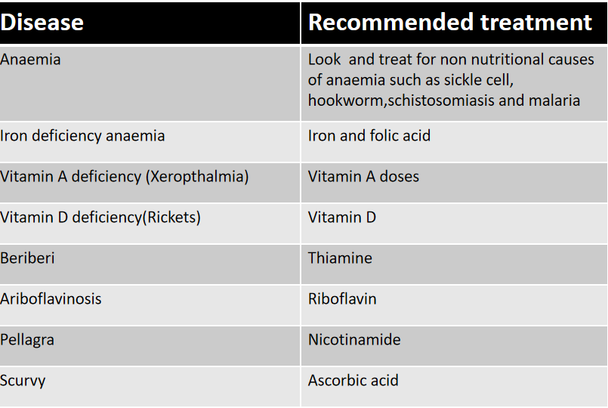
Recommended treatment for some important micronutrient deficiency disease

Slide 26
Nutritional status assessment
Nutritional status can be assessed through: Body measurements, used to measure growth in children & body weight changes in adults. Clinical examination & biochemical testing , used to diagnose deficiencies of micronutrients or hidden hunger (e.g., iodine, vitamin A & iron).
Why Nutritional Status Assessment?
Identify population at risk of malnourished
• Identify population who are malnourished
• Develop health care programs that meet community needs
• Measure effectiveness of community nutritional programs & interventions
Building Blocks of Anthropometry
• The four building blocks or measures used to undertake anthropometric assessment are: age, sex, length (or height) and weight

Slide 27
Anthropometric assessment is checking to see if a person’s body measurements, such as height/length, weight and arm circumference are within a desirable range of values.
Anthropometry information is used to evaluate both under & over nutrition.
Methods of nutritional status assessment
The four commonly used methods for nutrition status assessment are summarised as ABCD:
• Anthropometric methods, biochemical / laboratory, clinical and dietary assessment
The most frequently used method to assess community nutritional status is anthropometry.
• It is precise, accurate; and less expensive ( equipment and skills)
• It uses standardized technique;
• It is suitable for large sample sizes, such as representative population samples;

Slide 28
The z‐score (the standard index used in nutrition Assessments)
A z‐score is another measure of how far a child is from the median WFH of the reference (often written WHZ). In the reference population, all children of the same height are distributed about the median weight.
• Z‐score of a child being measured is the number of standard deviations the child is away from the
median weight of the reference population at the same height.
Weight for Height
Weight for height reflects recent weight loss or gain in relation to height. It is the best indicator of wasting and is thus the indicator used for determining acute malnutrition.
• Acute malnutrition as determined by weight for height is usually expressed as Global Acute Malnutrition (GAM) & Severe Acute Malnutrition (SAM).
Global Acute Malnutrition is the total number of children 6‐59 months whose WFH is less than ‐2 SD &/or has bilateral oedema.

Slide 29
Other Nutritional status of children between 6‐59 months:
• Wasting as defined by weight‐for‐height
• Stunting as defined as height‐for‐age
• Underweight as defined as weight‐for‐age
Oedema and Mid‐Upper Arm Circumference
Mid‐Upper Arm Circumference
• Mid‐Upper Arm Circumference (MUAC) directly assesses the amount of soft tissue in the arm & is another measure of thinness (or fatness) for children >65cm in height.
MUAC is the easiest index to use for screening to identify children in need of referral for further.
Growth Monitoring
Growth monitoring is the continuous monitoring of growth in children.
– Clinic-based growth monitoring (at Maternal and Child Health clinics)
– Community -based growth monitoring (conducted by trained members of the community in villages

Slide 30
Weight for Height
• Severe Acute Malnutrition is the total children 6‐59months whose weight‐for‐height is less than ‐3 SD and/or has bilateral oedema
• Bilateral oedema (pitting oedema) on both feet is the sign of kwashiorkor and is classified as severely malnourished even if the WFH z‐score or percent of median is “normal”.
Height for Age
• Height for age reflects skeletal growth and is the best indicator of stunting. This is the indicator used for determining chronic malnutrition.
Weight for Age
Weight for age is a composite index, which reflects wasting, stunting or a combination of the two.

Slide 31
Definitions of terms
Food value chain, stakeholders who participate in the coordinated production and value-adding activities that are needed to make food products
Food safety is the process of ensuring that food is safe for consumption by preventing contamination by microbes, toxins and chemicals.
Case of foodborne disease: any person become ill after consuming food considered to be contamited based on epidemiliogical evidence or labaratory testing.
Foodborne outbreak: two or more human cases of the same disease, observed under specified conditions. Situation in which observed number is greater than anticipated number
Food security is also defined as including both physical and economic access to food that meets people's dietary needs as well as their food preferences (FAO committee on world food security

Slide 32
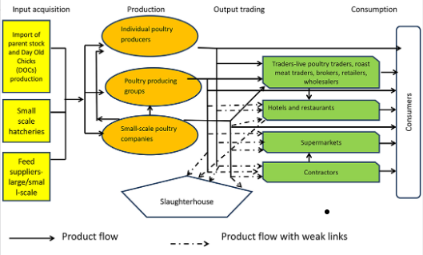
East Africa Community Value Chain for Poultry

Slide 33
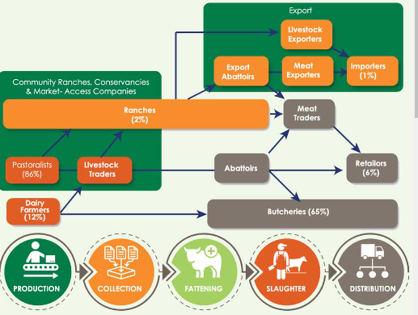
Kenya Value Chain for Milk and Beef

Slide 34
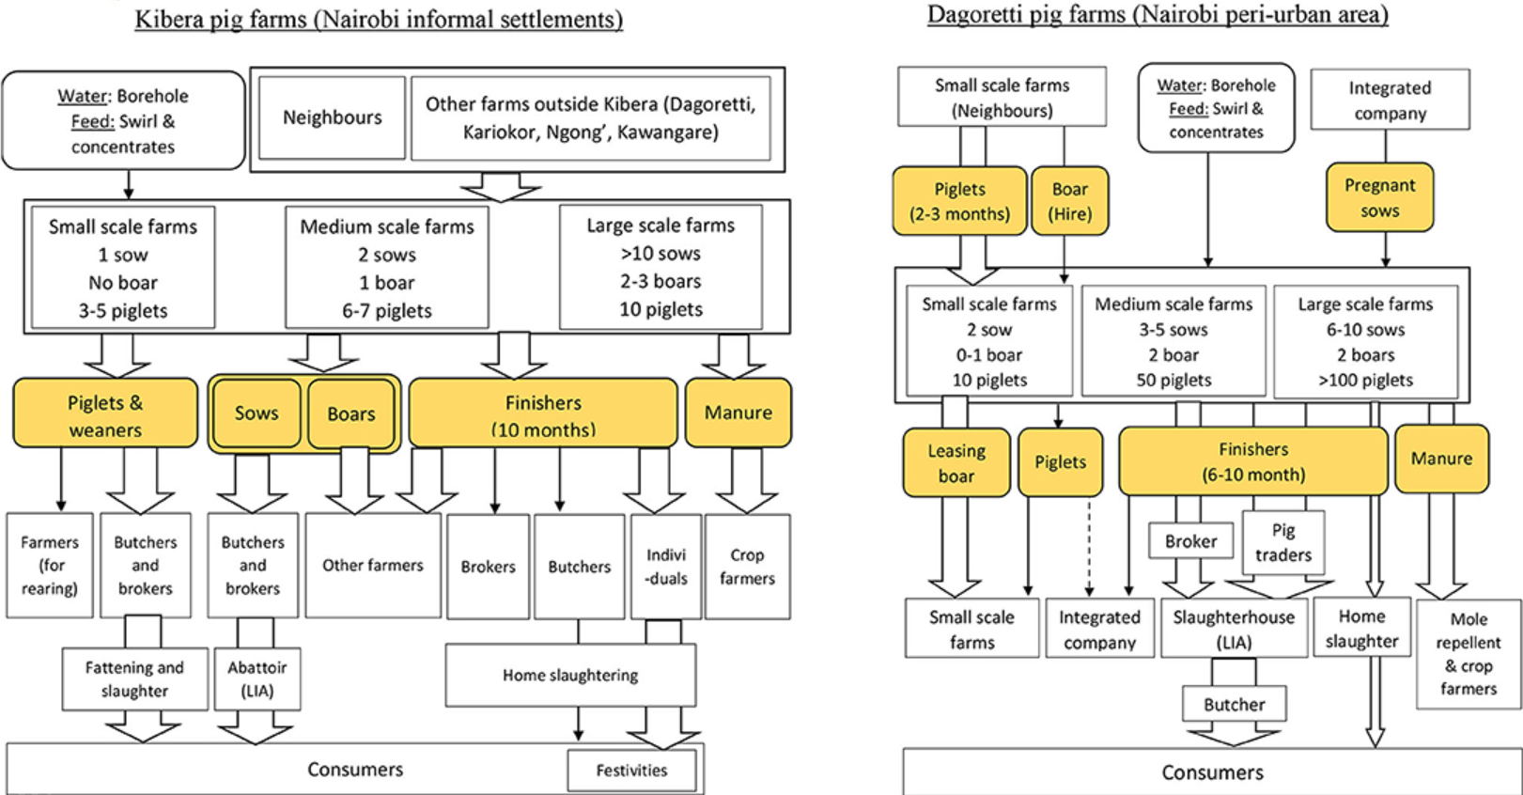
Value chain for Pork Production

Slide 35
Types of contaminants
Biological contamination
Biological contamination is the most common of the three types of contamination.
Can include viruses, bacteria ,parasites and other living agents.
Chemical contaminants
Any chemical used in your operation can potentially become contaminants if they are improperly used.
Chemical contaminants include pesticides, cleaning solutions, dangerous metal products (e.g., lead, copper, paint) and any foreign chemical that come into contact with food.
Physical contaminants
Any foreign objects that are accidentally mixed in with foods become physical contaminant.
They include glass, metal fragments (e.g., screws, staples), fingernails, hair, jewelry pieces.

Slide 36

Classification of foodborne disease by clinical presentation
Infectious acute disease
Gastroenteritis, Yesinia Sp.,Norovirus; Meningitis , Salmonella sp; Speticaemia, Brucella; Acute neurological symptoms, Clostriduim botulinum; Acute hepatitis, Hepatitis A, Hepatitis B; Perinatal loss, Toxoplasma gondii
Chemical acute
Gastroenteritis, organophosphates
Chronic disease
Reactive arthritis , Yesinia sp; Epilepsy , Taenia soluim; Irritable bowel syndrom, Giardia sp; Cancer, Helibacter pylori; Retinopath,Toxoplasma gondii; Multi-organ failure, Trichinella spiralis; Renal failure, Shiga-toxin producing E.coli
Chemical chronic
Neurodevelopement disorders, lead; Cancer Aflotoxin, arsenic, acrylamide, dioxins; Renal disease , cadmium

Slide 37
Common and emerging contaminants of food
Bacterial infections
Salmonellosis, Salmonella is commonly found in the intestines of birds and mammals. It can spread to humans via foods especially through meat and eggs.
Symptoms of salmonellosis, diarrhea, fever and abdominal cramps.
S.Typhy cause typhoid fever and a number of other species cause food borne gastro-enteritis.
Bacillary dysentery (shigellosis), Caused by shigella dysentriae
Transmission is favored by overcrowding; food handler and flies are the vehicles of transmission.
E. coli symptoms include severe diarrhea, cramps, and dehydration.
Campylobacter is a common identified bacterial cause of diarrheal illness.
Raw poultry meat, bacteria can live in the intestines of healthy birds. Eating undercooked chicken, or ready-to-eat food in contact with raw chicken, is the most common food-borne source of this infection. It causes fever, diarrhea, and abdominal cramps.

Slide 38
Viral infections
Hepatitis A virus has been implicated in several outbreaks.
Hepatitis A is a mild illness with symptoms including fever, malaise, nausea, anorexia and abdominal discomfort followed in several days by jaundice.
Infectious agents are found in feaces.
Salads that is not cooked and contaminated by food handlers are the source of the problem.
Protozoa e.g., Entamoeba histolitica ,toxoplasma gondii and giardia lamblia.
Entamoeba histolytica cause amoebic dysentery.
Vehicles of transmission; raw vegetables, and fruits due to contamination.

Slide 39
Trematodes; Flukes e.g., Fasciola hepatica. A parasite of sheep and cattle in which snails act as intermediate host. Eating contaminated salads can infect man.
Cestodes; e.g., tape worm (T.solium and T.signata).Humans being may be infected following the consumption of inadequately cooked pork (T,solium) or beef (T.signata).
Fish tape worms;
Due to consumption of raw/insufficiently cooked fresh fish that carry larvae of the parasite.
Nematodes; e.g., Trichinosis
Due to consumption of uncooked/insufficiently cooked pork, beef or horse meat.
Symptoms include; vomiting, fever, etc. Subsequently larvae penetrate muscles including the brain where they cause paralysis.

Slide 40
Food poisonings (toxic poisoning or chemical poisoning)
a) Food borne toxins
The toxin might be a natural part of the plant consumed.
Foods with natural toxicants are not a big problem if taken in tolerable amounts. Excessive intake of certain foods can cause poisoning.
Examples of naturally occuring toxins in some selected food stuffs.
Toxigenic fungi; Toxins that can be produced in plants by naturally occurring fungi e.g., mush room.
Akaloid solanine can develop in potato/cassava tubers when exposed to light
Foods of brassica family (cabbage, onions) contain goitrogens and are toxic metabolites, which prevent adequate absorption of iodine.
Some beans (Soya and black beans) have fauvism toxins which can agglutinate red blood cells.
Certain peanuts, fruits can cause allergic reactions to the skin and gastrointestinal tract.

Slide 41
b) Mycotoxins
Toxic metabolites of moulds/fungi, which contaminate various foods.
Aflatoxins; originate from aspergillus flavus. It found in cereals grains, nuts and milk and cause liver damage and cancer.
Citrin; produced by penicillium citrinum. It found in wheat, oats, and rice and Can cause fatty liver.
The types of bacteria that produce toxins are; Staphylococcus aureus, Clostridium botulinium (Botulism), Clostridium perfringens (Gastro enteritis).
Food additives and preservatives (Chemical substances introduced by human activities)
Nitrates and nitrites
Common ingredients of nitrogen fertilizers
High concentration of nitrate in baby food cause methermoglobinemia in infants.
The recommended amount of nitrate in drinking water is 45mg/litre.

Slide 42
Sodium chloride (salt)
Scientific data indicates that excessive intake of salt is related to hypertension.
The recommended intake of sodium is 3-4 gm/day.
For children and adolescent is 2-3 gm/day
Phosphate
Phosphate is being excessively used in the processing of poultry feeds and in the production of soft drinks.
An excessive intake of phosphate may lead to premature cessation of bone growth in children.
May contribute to osteoporosis in the elderly.
Recommended daily intake is about 1200mg

Slide 43
Metals
Mercury
Large scale poisoning has caused deaths and cases of permanent damage to the CNS. This situation occurred in minamata Japan when more than 100 people who ate contaminated fish were poisoned and 46 died.
Lead: Can be digested indirectly in form of lead base paints from contaminated drinking water. Such water can be contaminated by lead pipes, vessels . Vegetables by the road side are often contaminated by atmospheric deposition. It affects the nervous system and the kidneys.
Cadmium : from batteries. Affects the kidney and may relate to hypertension and renal cancer.
Pesticides
They may contaminate food with high toxic levels after accidental contamination.Residuals may also remain in or on treated food products and onto food chain.

Slide 44
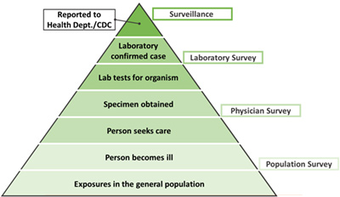
Monitoring pyramid for foodborne diseases
Monitoring of cases of infectious diseases ( health care practitioner based)
Monitoring of cases of infectious diseases ( laboratory based)
Monitoring of consumer complaints
Need for organized continuous reporting!!!!
Under reporting!!!

Slide 45
Approaches to prevention of food contamination
The cost of poor hygiene
Food poisoning outbreaks and sometimes death, Food contamination, Food infestations, Food spoilage
Fines and costs of legal actions and civil actions taken by food poisoning sufferers
Decontamination, cleaning and replacement of damaged equipments.
Why we need to know about food hygiene
To create awareness among consumers and reduce the number of diseases in community
To create standards, guidelines and recommendations
To promote food security, control and prevent food borne diseases
Compliance with the law, increased self life of food and good working conditions

Slide 46
Keys to safer food
Proper food preparation can prevent many food borne diseases. WHO has developed a global food hygiene message with five key steps that promote health, the Five Keys to Safer Food.
Keep clean
Wash hands properly before handling food and often during food preparation.
Wash hands after going to the toilet
Cover the wounds or cuts on hands or arms properly with waterproof plasters.
Protect kitchen areas and food from pests and insects
Separate raw food and ready to eat food
Store ready to eat food at upper apartments to prevent it from being contaminated by the dripping of raw food.
Use separate knives and cutting board for raw foods and ready to eat food.
Cover or wrap food properly to prevent cross contamination.

Slide 47
Cook food thoroughly
Cook food thoroughly esp. meat, poultry, eggs and sea food
Consume cooked food within two hours
Keep food at safe temperatures
Do not leave food at room temps for more than 2 hours
Keep cold dishes and perishable foods in refrigiration at below 4 deg c.
Keep hot foods in heating containers above 60 deg c prior to serving.
Use safe water and raw materials
Buy raw materials from reputable shops (select fresh food)
Wash raw fruits and vegetables thoroughly, Especially if eaten raw, Do not use food beyond it’s expiry

Slide 48
Food hygiene is more cleanliness, it involves ; protecting food from the risk of contamination , preventing bacteria multiplication and destroying harmful bacteria in the food
Protect food from contamination
Keeping food covered wherever possible
Not using unsuitable or dirty equipments
Not using dirty wiping clothes
Separate raw and cooked food at all stages of prep., storage and distribution.
Prevent flies and rodents entering food rooms or getting in contact with food.
Store food in rodent proof containers
Maintain high standards of personal hygiene at all times

Slide 49
Promptly disposing off wastes and refuse
Keeping the food and equipment off the floor
Preventing bacteria within food from multiplying by:
Not allowing dried food from absorbing the moisture.
Storing food at suitable tempratures (below 5 deg c,or above 63 deg c)
Using suitable preservatives
Destroying any bacteria within food
Thorough cooking
Heat processing like sterilization and pasteurization.

Slide 50
Requirements of food handlers
Requirements relating to food handlers and handling of food;
Health status
People known, or suspected to be suffering from, or to be a carrier of a disease or illness likely to be transmitted through food should not be allowed to enter any food handling area if there is any likelihood of food contamination.
Medical examination should be carried out.
Conditions to exclude from food handling;
Jaundice, vomiting, fever ,visible infected skin lesion, discharge from ear, eyes and nose.
Personal cleanliness
Food handlers should maintain high degree of personal cleanliness.
Wear clean, adequate clothing and head covering
Bathe daily with soap and water
Wash their hair and brush their teeth daily
Food handlers should wear clean and washable over clothing. They should change it whenever dirty.

Slide 51
Refrain from smoking, coughing, sneezing, spitting over unprotected food and always wash their hands.
•Cuts and wounds should be covered by suitable waterproof dressing.
•Jewelry should not be worn or brought into food handling area if they pose a threat to the safety.
Requirements related to food premises
•An adequate supply of safe water with appropriate facilities for its storage should be provided.
•An adequate drainage and waste disposal systems should be provided.
•Adequate changing and personal hygiene facilities to washing and drying hands.
•Facilities for washing food and equipment: in form of sinks should be provided.
•If necessary, adequate facilities for the storage of food, ingredients and non-food chemicals.
•First aid materials, cloak room, good lighting and ventilation should be provided
•Food rooms shall not communicate with sleeping room

Slide 52
Cleanliness and general repair of food rooms
Walls , floors, doors , windows and ceilings shall be kept clean , in good order, repair and condition; as to:
To prevent any risk of infestation by rats and insects
Solid waste management
No refuse or solid waste shall be allowed to accumulate in any food room
Temperature at which foods must be kept in regard to meat, fish, eggs or milk production
Cooked foods to be kept at temperature of 62.7 _ 10-degree Celsius ( 145 F-50 F) under hygienic conditions prior to serving
Sanitary conveniences
Should be clean, no odor, good light and ventilated, good hand washing facility
Food rooms shall not communicate with a sleeping room !!!

Slide 53
World Trade Oganization ( WTO) agreement governing food control
Sanitary phytosanitary measures (sps) Agreement
Technical Barriers to Trade Agreements
Functions of WTO
Negotiate trade rules and Implement trade agreements
Resolve trade disputes and Review national trade policies
What are SPS Measures?
Any measure to protect human, animal or plant life or health from certain risks, and which may affect international trade, e.g product criteria, quarantine measures, processing requirements, certification, inspection and testing, etc
It is the objective of the measure that counts – not the type of measure
Measure are based on risk assessment and international standards ( Art 3 & 5)

Slide 54
Objectves of SSP
avoiding
unnecessary
barriers to trade
recognizing the right to protect
human / animal / plant life or health

Slide 55
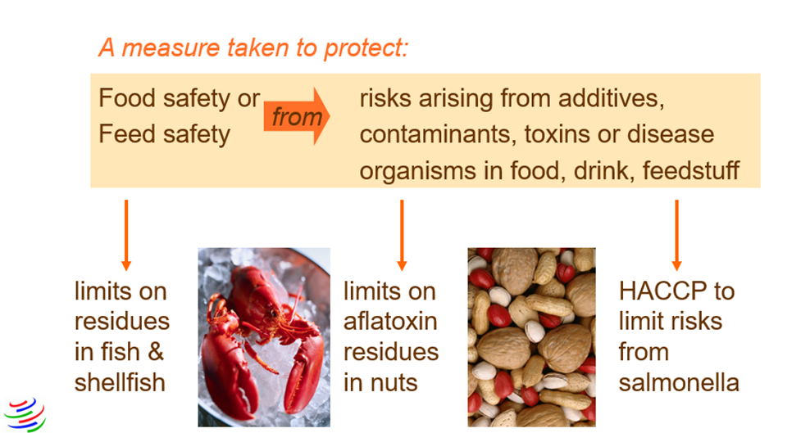
SPS Measures - Examples

Slide 56
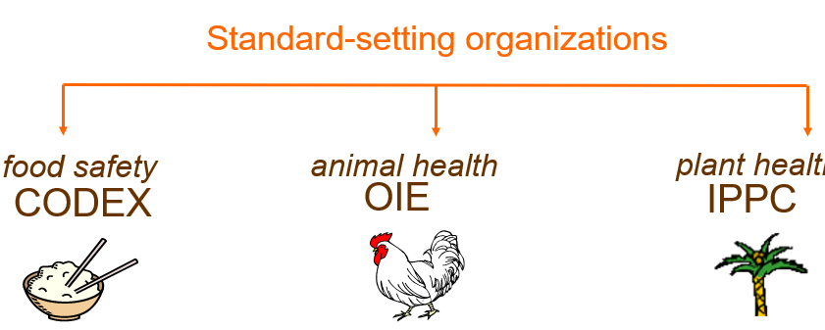
Key Provisions
Harmonization, Article 3, Annex A

Slide 57
International plant convention protection
Established in 1951 with its head office in Rome and
It publishes international standards for plant protection.
Being founded by an international convention, it does not have members as the others, but contracting parties, i.e. Countries that have acceded to the convention.
World organization for Animal health
Established in 1924 with its head office in paris and
It publishes international standards for animal health.
It has a membership of just over 180 countries.
International: Codex Alimentarius
Collection of standards for food safety and product quality in the United Nations,
First published in1963 by FAO and WHO

Slide 58
Coordination of fair trade with food on an international level and securing of health protection of consumers with worldwide standards
Contents: Food labeling, limit values, risk analysis methods, animal feed, special regulations e.g. for animal products, infant food, dietary food
Customers of FAO / WHO Risk assessment bodies
Codex Committees
  Sound scientific advice as a basis for standards, guidelines and recommendations
  Answers to specific questions on pathogen commodity combinations
WHO, FAO and Codex Member Countries
  - “Adaptable” risk assessments to use in conducting their own assessment
  - Modules with direct application

Slide 59
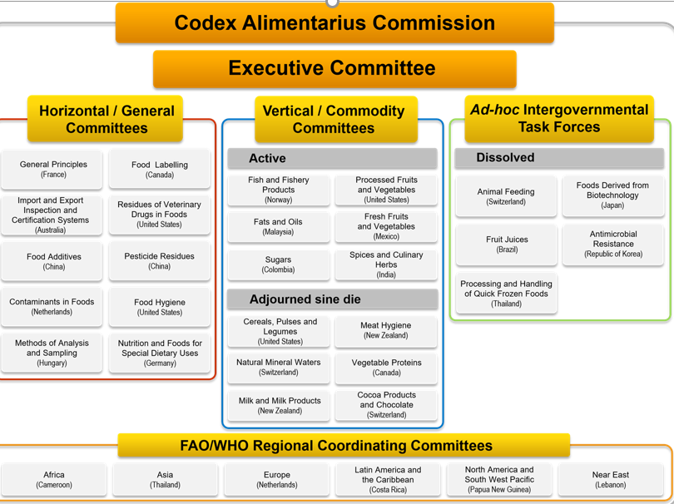

Slide 60
Agreement on Technical Barriers to Trade (TBT)
Measures
WTO TBT, seeks to prevent unnecessary obstacles to trade arising from
technical regulations and Standards
Conformity assessment procedures –testing, certification, calibration and verification
Applicable to all goods
  technical regulations (mandatory)
  standards (voluntary)
  conformity assessment procedures
But its provisions do not apply to SPS measures

Slide 61
SPS vs TBT
SPS
human or animal health from food-borne risks
animals and plants from pests or diseases
E.g.
  pesticide residues and food additives
TBT
human disease control (unless it’s food safety)
nutritional claims
food packaging and quality
E.g. labelling (unless related to food safety), pesticide handling

Slide 62
International organization for standardization ( ISO)
A Non-Governmental Organization (NGO),
Established in 1947, its head office in Geneva
Publishes wide-ranging International Standards for scopes generally not handled by the others in this list.
Its members are the foremost standards organizations in their countries and only one member per country
Regional standards bodies ( RSBs)
RSBs established as a voluntary organization within given geographical regions, e.g. Africa
Two categories
RSBs established through political processes aligned with the regional trade arrangements, e.g. common markets and free trade areas (FTAs); or
RSBs established as a voluntary organization within given geographical regions, e.g. Africa and the Pacific rim

Slide 63
Roles of countries
Participate actively in the work of Codex
Countries must base all decisions on sound science
Strengthen their NCC,s including Technical Committees to provide technical support
Strengthen food control systems including surveillance and laboratories for generation of scientific data for Codex work
The application of risk analysis should be established as an integral part of a national food safety system
Implementation of risk management decisions at the national level supported by functioning food control system/program
Risk analysis should be applied consistently, open, transparent and documented and evaluated and reviewed

Slide 64
National standards bodies ( NSBs)
Many countries have established centralised NSBs in the past hundred years.
NSBs may be
Government department
An organization of public law (i.e. a statutory body), or
An organization of private law
NSBs primary responsibilities include:
Development and publication of National Standards,
Provision Of Standards Related Information
Liaison With Regional And International Standardizing Bodies.
Provide standards related services such as inspection, testing, certification and training.

Slide 65
Food security
The World Food Summit of 1996 defined food security as existing
“when all people at all times have access to sufficient, safe, nutritious food to maintain a healthy and active life”.
3 pillars of food security:
Food availability: sufficient quantities of food available on a consistent basis.
Food access: having sufficient resources to obtain appropriate foods for a nutritious diet.
Food use: appropriate use based on knowledge of basic nutrition and care, as well as adequate water and sanitation.

Slide 66
Nutrition security
It has secure access to food coupled with a sanitary environment, adequate health services, and knowledgeable care to ensure a healthy life for all household members. (IFPRI,2004)
Focuses not only on access to food, but on its utilization as well.
Every human being has a right to food; commitments to the right to food!!
Universal Declaration of Human Rights (1948), Article 25
International Covenant of Economic, Social, and Cultural Rights (1966),Article 11:
Rome Declaration on World Food Security (1996)
United Nations Millennium Declaration (2000)
Sustainable development Goals ( 2015)

Slide 67
References
WHO ( 2023 ), addressing nutrition in emergencies: https://www.who.int/activities/addressing-nutrition-in-emergencies
Biological and chemical hazards in food and food products (no date). Available at: https://www.routledge.com/Biological-and-Chemical-Hazards-in-Food-and-Food-Products-Prevention-Practices/Mishra-Goyal-Gaare/p/book/9781774637135 (Accessed: January 27, 2023).
Micronutrient malnutrition, policies and programs for control and their implication. Underwood. B.A and Smitasiri: Annual Review of Nutrition, Vol 19, page 303
Admin (2020) Admin, Food Safety Training and Certification. Available at: https://foodsafetytrainingcertification.com/food-safety-news/introduction-to-biological-food-hazards/#:~:text=Biological%20food%20hazards%20are%20also,biological%20foodborne%20pathogens%20are%20microscopic. (Accessed: January 27, 2023).
FAO & WHO (2022) https://www.fao.org/fao-who-codexalimentarius/about-codex

Slide 68


The Pandemic Preparedness under a One Health approach (PPOH) short course is developed by the East African Community (EAC) Secretariat in cooperation with universities of the six EAC Partner States. It is facilitated by the German Government and implemented by the Deutsche Gesellschaft für Internationale Zusammenarbeit GIZ GmbH through the Global Programme Pandemic Prevention and Response, One Health (GP PPOH)

